Slide 1
Lab 1a
https://etc.jerl.im/2030lab1a.pptx
http://l.jerl.im/dHi (if you’re lazy to type)

Slide 2
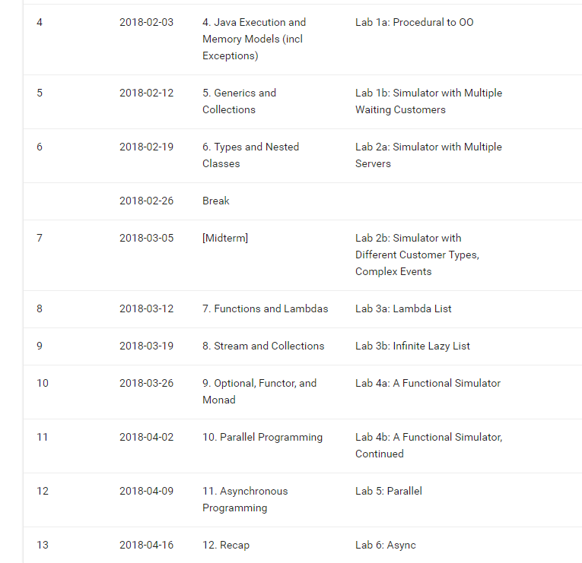
Lab Grading

Slide 3
SOC VPN
https://docs.comp.nus.edu.sg/node/5065
Need FortiClient
Windows 10 users – Install from App Store to avoid the “antivirus”

Slide 4
UNIX Cheat Sheet (for this mod)
Copy a file: cp [source] [destination]
Copy a directory: cp -r [source folder] [destination]
File transfer a folder: scp -r [source] [destination] from your computer
Referring to a remote location: username@server:directory
E.g. jerlim@cs2030-i.comp.nus.edu.sg:~cs2030/lab1a
Submit lab: ~cs2030/submit01a from your lab folder

Slide 5
Super Cheat Sheet
Login: ssh username@cs2030-i.comp.nus.edu.sg
Copy the lab to your folder: cp ~cs2030/lab01a . ← note the dot
exit
Copy the lab from the server to your computer:
scp -r username@cs2030-i.comp.nus.edu.sg:lab01a .
Do your stuff
Upload to server:
scp -r lab01a username@cs2030-i.comp.nus.edu.sg:lab01a
Login and submit:
cd lab01a
~cs2030/submit01a

Slide 6
I prefer to use FileZilla ☺
CS2030 course directory: /home/course/cs2030/

Slide 7
Lab 1a: Simulator

Slide 8
Intro
Ungraded lab
Ask us for feedback if you need!
https://nus-cs2030.github.io/1718-s2/lab01a.md
We will be using this Simulator for the next few labs
Better design now = less work later
More effort put in = greater understanding = better exam marks

Slide 9

Key tips
Think very hard about names
In 6 months time, will you be able to understand your code easily?
Can you describe ifs and whiles with verbs? Then make it a method.
But don’t go overboard. Keep it simple.
Can a stranger understand your code without comments?

Slide 10
Key tips
Think about what methods and attributes logically go together
Make it a class
Avoid getters / setters (for this mod)
Information vs data
Describe what you’re doing instead of fetching data
E.g. server.isFree() vs (server.getServing() == null)
Tell instead of do
E.g. server.serveCustomer(c) vs if (…) server.setServing(c)
Make it easy to add new features
Hint: See the lab schedule

